Slide 1
Company and Brand Overview
March 31, 2022

Slide 2
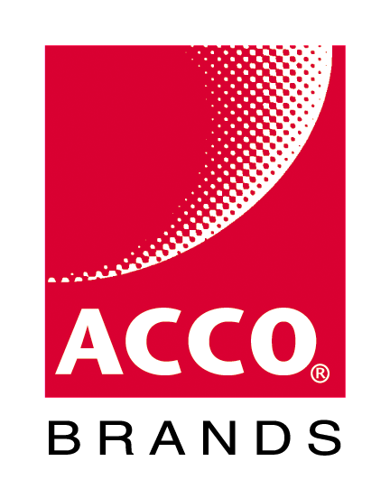

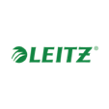







Kensington is a division of ACCO Brands, Inc.
ACCO has more than 45 brands around the globe
Technology represents over 25% of ACCO Brands
$2B annual revenue
Kensington is one of the top 3 brands in ACCO’s portfolio
Kensington revenue has grown over 12%
in the past five years

Slide 3

Who We Serve
At Kensington, we identify areas where the modern workplace needs to be better, and craft professional-tier product solutions for organizations committed to inspiring their workforce to perform at its peak.
IT Buyer
Home Office Professional
OEM
Hybrid Worker

Slide 4
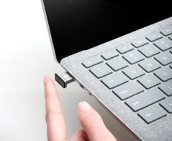
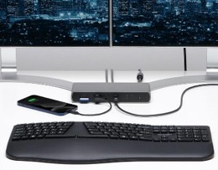

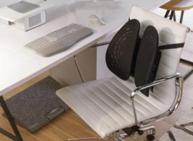
Our Focus – Building products that elevate the end user’s experience with technology
Data Protection
Connectivity
Pro Videoconferencing
Ergonomics & Wellness
From the invention of the first computer lock, to multi factor authentication and electronic locking, Kensington will keep your devices and information right where they belong.
Universal connectivity and productivity solutions tested above industry standards and designed to work with multiple brands of desktop and mobile computing devices.
Visual and audio tools that work seamlessly together to enable a flawless online videoconferencing experience for the in-office, at-home, or hybrid work professional.
Empowering professionals to compute and create content at the highest comfort and productivity level, Kensington ergonomic solutions are scientifically proven, simple to set up, and built to last.

Slide 5




Partnering with the Top Names in Tech
We’re proud of the partnerships we’ve fostered with industry leaders to help ensure the highest level of design, form, fit, function, performance, security, and compliance.
Microsoft
Apple
Intel
Synaptics
AMD
Google

Slide 6
Timeless Core Values
Quality
Support
Design
Sustainability
With over 40 years of experience in engineering and high-volume IT-related manufacturing, Kensington’s rigorous quality control means all products are tested above industry standards.
Kensington’s clients are around the world and include companies large and small. Every customer is treated as a top-tier professional, no exceptions.
Through meticulous research, design and engineering, Kensington award-winning solutions meet the ever-changing performance and compatibility needs of the peak professional.
Dedicated to finding ways to reduce our environmental footprint, in every aspect of our business.

Slide 7


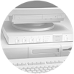











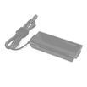









Over 40 years of Adapting to an Everchanging Workplace
Proximo Key Fob & Tag Bluetooth Tracker
MiniSaver
Mobile Lock
SmartFit One-Touch Height Adjustable Dual Monitor Arm
System Saver
for Apple II
SlimBlade Trackball
AbsolutePower
& SecureBack
StudioDock
MasterPiece
Mouse in a Box
ComboSaver
FM Transmitter
Thunderbolt 3
Docking Station
1981
1990
1996
2000
2005
2009
2011
2013
2015
2017
2019
2021
1986
1992
1997
2003
2007
2010
2012
2014
2016
2018
2020
Thunderbolt 3 4K Dock w/K-Fob SmartLock
VeriMark IT Fingerprint Key
Turbo Mouse
MicroSaver & Security Slot
PocketMouse Wireless
Laptop Power with USB
KeyFolio X3 for iPad Air
Game Pad
Presentair
QI Laptop Riser
KeyFolio & ClickSafe
Acquired by ACCO Brands in 1986

Slide 8




























Patents and Awards
Over 288 design
& utility patents awarded in 14 countries in the past 23 years
Over 50 product design awards in the past 16 years
2022 | 2021 | 2019 | 2018 | 2017 | 2016 | 2015 | 2014
2 AWARDS
1 AWARD
1 AWARD
1 AWARD
1 AWARD
1 AWARD
3 AWARDS
Industrial Designers Society of America
2013 | 2012 | 2011 | 2010 | 2009 | 2008 | 2007 | 2006 | 2005
5 AWARDS
4 AWARDS
4 AWARDS
1 AWARD
4 AWARDS
5 AWARDS
2 AWARDS
2 AWARDS
1 AWARD
Industrial Designers Society of America

Slide 9
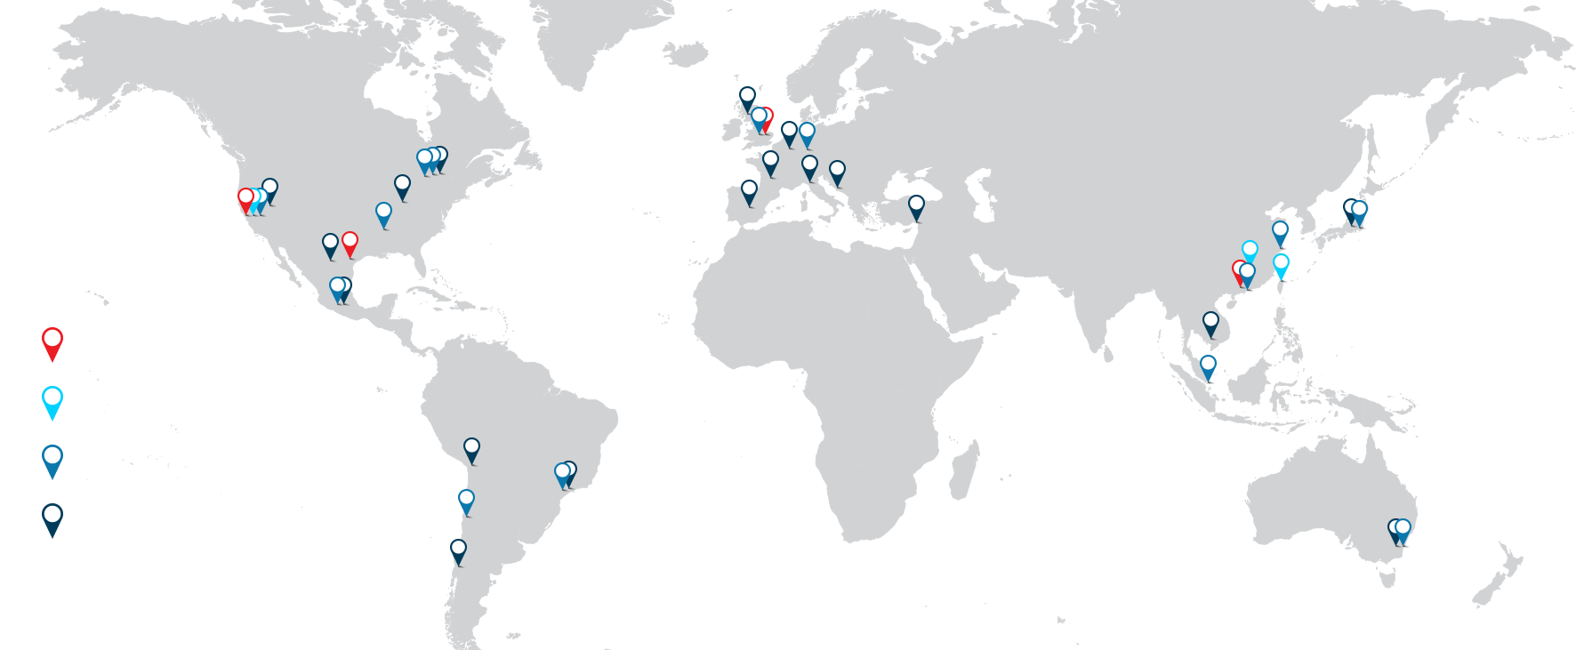
Global Presence
Kensington’s brand is recognized around the globe for leadership in our core categories.
Admin
R&D
ACCO/Kensington Distribution Centers
ACCO/Kensington Sales and Marketing

Slide 10
Data Protection
Kensington data protection solutions range from hardware device security – the first line of defense in data protection – to multifactor authentication to visual privacy protection.
A leader in the physical security market, Kensington is the brand that companies
trust to innovate and adapt solutions for ever evolving work environments and potential security risks.

Slide 11



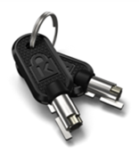





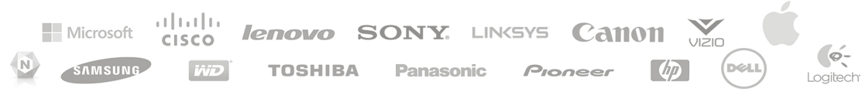
Decades of Security Slot & Lock Leadership
Kensington invented the Security Slot
The Kensington Security Slot has been an industry standard for over 30 years.
More than one billion devices around the world have Kensington Security Slots.
Nearly 38 million Kensington locks have been sold over the last 30 years.
Kensington locking solutions are compatible with 100% of laptops, projectors, printers and monitors with security slots sold worldwide by some of the most popular brands in tech.
Laptops
Printers
Projectors
Gaming Consoles
Hard Drives
Access Points
TVs
Docking Stations

Slide 12
What Sets Kensington Apart
5mm Common Keying
Customers with existing Kensington locking systems can expand their lock portfolio with same 5mm keying system – compatible across the latest locks
Custom Keying
With options like like-key, supervisor key and master key, organizations can customize their lock ecosystem to meet their needs
Register & Retrieve
Individuals and organizations alike can manage their keys and lock combinations and even request replacement keys through a single online tool

Slide 13
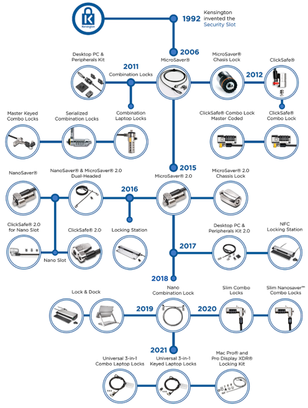
An Evolution in Locking Design
The device landscape is changing, as are lock styles.
Kensington is at the forefront of innovation in physical device security:
Slot-less locking solutions that secure thin and light devices with no lock slot
Locks that accommodate today’s ultra-thin devices and any type of lock slot
Electronic locking using a K-Fob instead of a traditional key
Electronic and hybrid device lock and dock solutions that combine connectivity and peace of mind

Slide 14

Beyond Physical Security — Passwords are Not Enough
80% of hacking-related data breaches involve compromised or weak passwords.¹
Multi Factor Authentication blocks a staggering 99.9% of enterprise account hacks.²
Not all MFA methods are equally secure
According to the FBI “Multi-factor authentication continues to be a strong and effective security measure… Consider using additional or more complex forms of multi-factor authentication
for users and administrators such as biometrics…” ³
Global Multi-Factor Authentication Market TAM: $20.41Bn USD in 2025.
¹ Verizon Data Breach Report 2019 ² Microsoft Study ³ FBI Private Industry Notification, September 2019

Slide 15























VeriMark™— Biometric Authentication
Verimark is a family of mobile and desktop biometric devices:
FIDO U2F and FIDO2 (Windows Login Security, Multi-factor
Authentication, Web authentication) support
Match-in-Sensor Fingerprint Technology
360° readability with anti-spoofing technology while
exceeding industry standards for False Rejection Rate
(FRR 2%) and False Acceptance Rate (FAR 0.001%)
Supporting a number of platforms: Windows end
users (Hello and Hello for Business) as well as
cross platform services, Microsoft accounts,
Dropbox, Facebook, Google services and others.

Slide 16

Visual Hacking is on the Rise
In a study of 500 global IT professionals…
91% felt that protecting sensitive information on screen from onlookers was either somewhat or extremely important
69% stated that they had a
Visual Privacy Policy in place
An experimental study conducted by the Ponemon Institute demonstrated a 91% success rate of global visual hacking attempts
Ponemon Institute Study, 2016

Slide 17
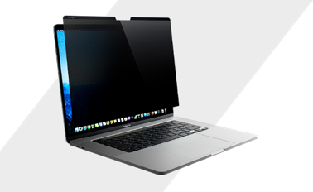
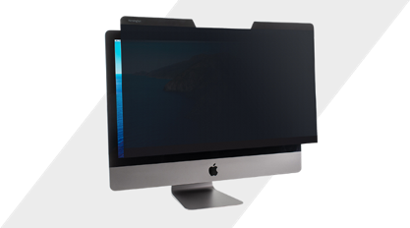
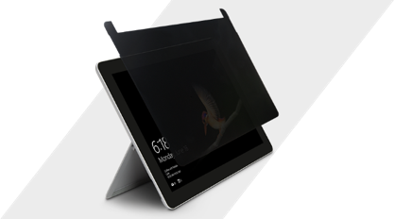
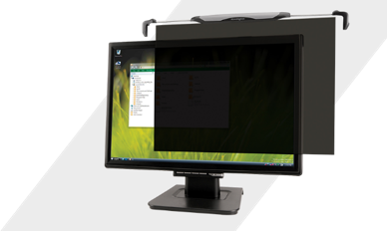
Privacy Screens – The Ideal defense against wandering eyes
Kensington privacy screens reduce the risk of exposing sensitive and valuable information to unwanted viewers. Whether on the move or in the office, there is no need to change your usual working position to protect your data from prying eyes. Work without disruption with a Kensington Privacy Screens.
Limits viewing angle +/- 30°
Anti-reflective surface reduces glare
Filters harmful blue light
Available in a wide variety of sizes and installation methods for tablets, laptops, and desktops

Slide 18
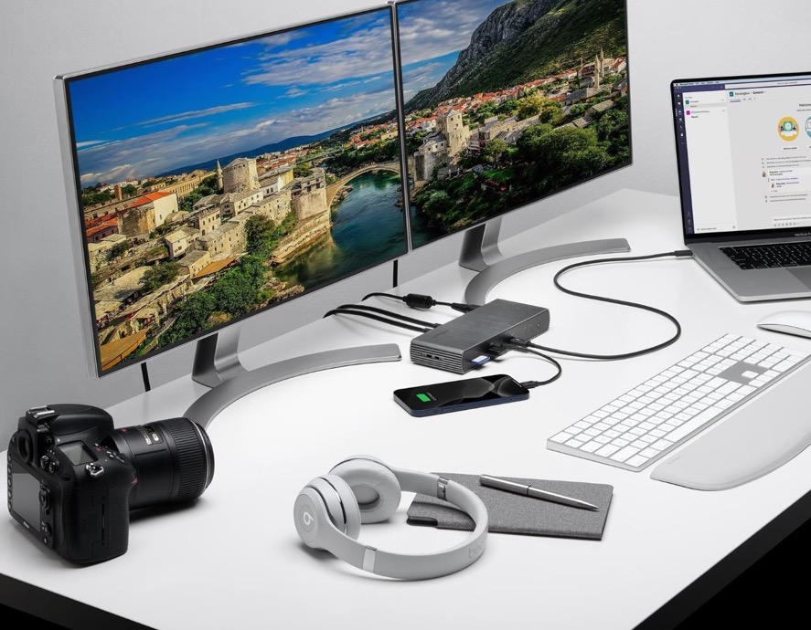
Connectivity
Kensington connectivity products address
the changing landscape of office computing.
From VESA mounts that promote cleaner workspaces to the industry’s first Universal Thunderbolt 4 docking station, we are taking a leadership position in this space.

Slide 19
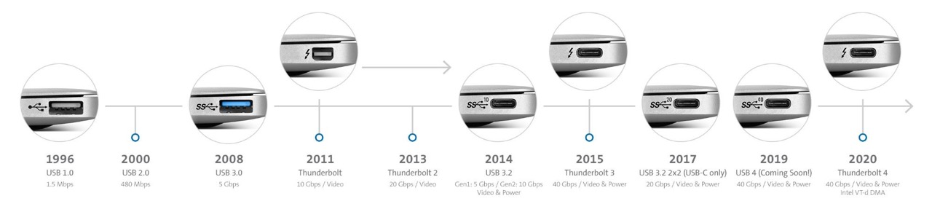
Connectivity — Evolution of Universal Connectivity

Slide 20




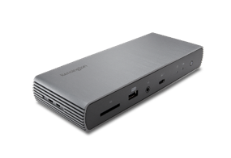

Connectivity — Universal Docking
USB Type-C opens door for increased growth in universal docking – One connector carries:
    Video (native DisplayPort support)
    High-bandwidth USB data up to 40Gbps
    Power Delivery
PC manufacturers sell branded universal docks as part of bundle solutions.
Kensington universal docks are tested and proven to work across all major PC brands.
Kensington’s technical support team will troubleshoot and resolve issues with a Kensington dock and all major PC brands.

Slide 21
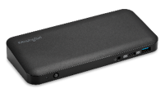
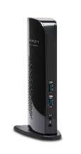
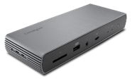
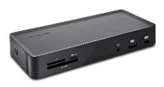
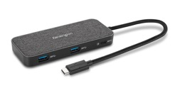
Universal Docking Solutions
Docking stations to suit a variety of technology and connectivity needs at the desk or on the go
Driverless (USB-C)
SD4840P
Thunderbolt 3 & 4
SD5700T
DisplayLink (USB-A)
SD4100v
Hybrid (USB-C & USB-A)
SD4900P
Mobility
SD1650P

Slide 22
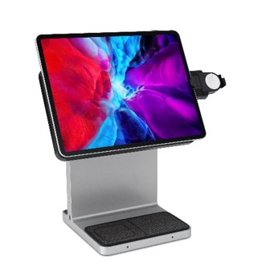
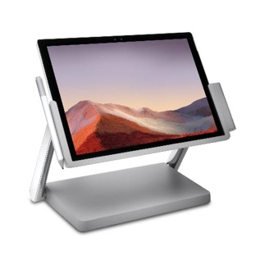
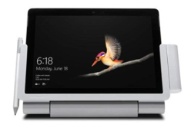
Docking Innovation
Docking solutions that not only connect, but create a versatile user experience, turning a tablet into desktop PC experience.
StudioDockTM iPad Pro Docking Station
SD6000 Surface Go Docking Station
SD7000 Surface Pro Docking Station

Slide 23
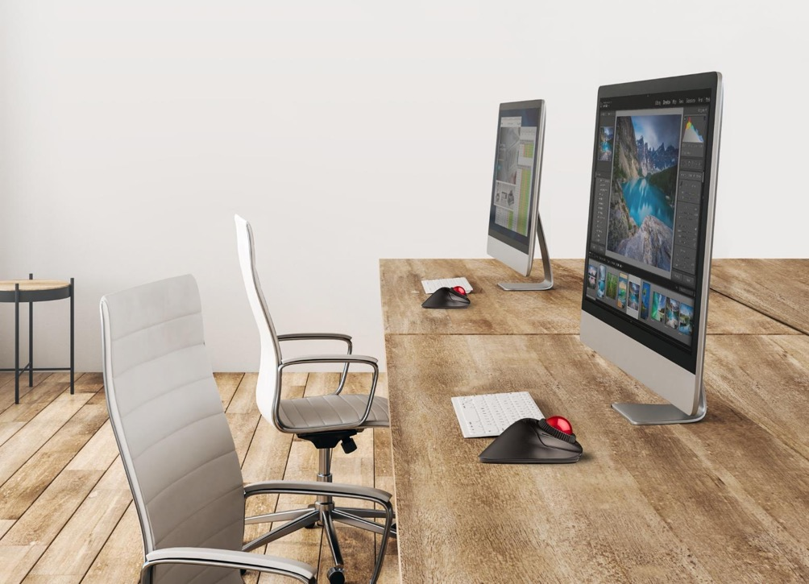
Input Devices
Remote working environments are on the rise. Kensington’s input portfolio complements this trend.
With dual-wireless solutions, AES encryption, customizable features, and more, Kensington’s solutions help make work life easier.
We create innovative, personalized,
and reliable products to embody
the needs of all professionals.

Slide 24
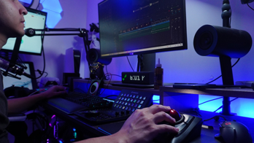
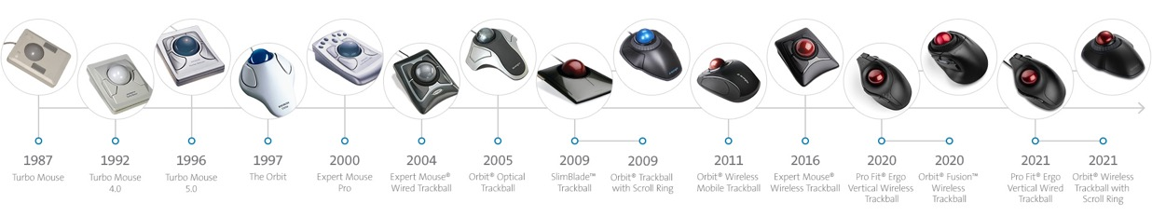
Decades of Leadership & Innovation in Trackballs
Kensington trackballs are the “go to” standard for technical and creative professionals around the globe.
Music and video producers, designers, and engineers enjoy the precision and ergonomics of having the right trackball in their toolkit.

Slide 25
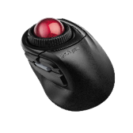
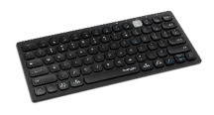
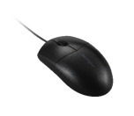
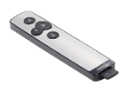
Input Portfolio
Kensington mice, trackballs, keyboards, and presentation remotes are made with ergonomics, comfort, efficiency, productivity, and style in mind. Mice that fit the hand perfectly, trackballs that let you customize each button for a truly personalized computing experience, keyboards that are responsive and quiet, and wireless presentation remotes that help you take control of a room and present with confidence.
Orbit® Fusion™ Wireless Trackball
Multi-Device Dual Wireless Compact Keyboard
Pro Fit® Wired
Washable Mouse
PowerPointer Presentation Remote

Slide 26
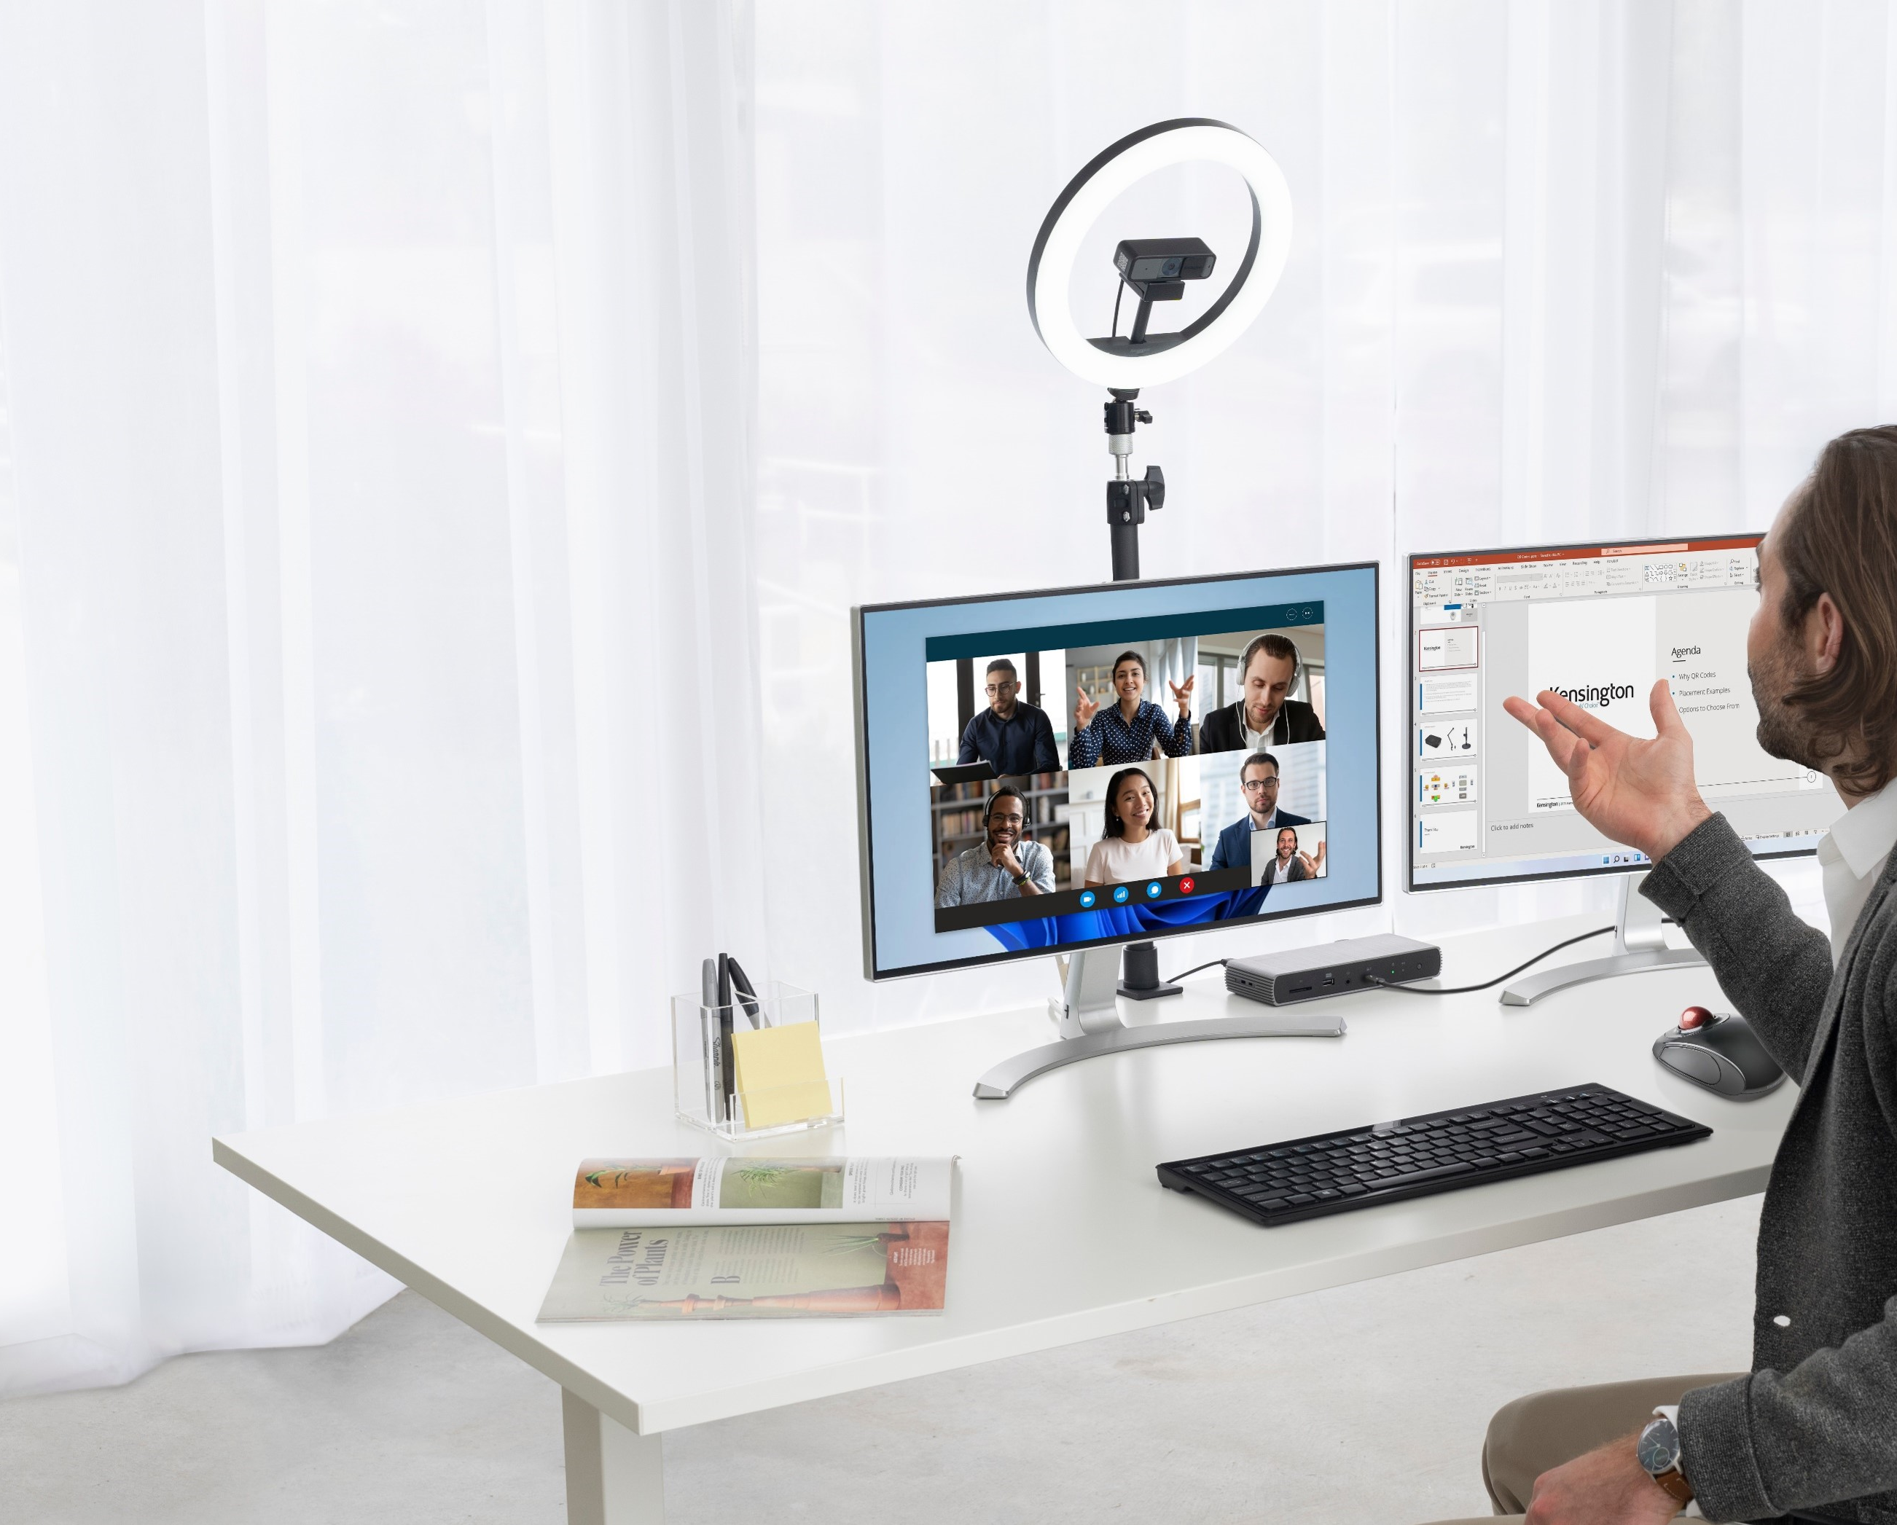
Pro Videoconferencing
Whether working from home, in the office, or somewhere in between, connecting via video conferencing has become the standard for business meetings. Kensington Pro videoconferencing solutions are designed to work seamlessly together to enable the modern professional to be clearly seen and heard for effective communication and presentations.

Slide 27
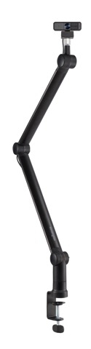
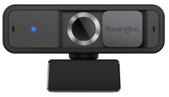
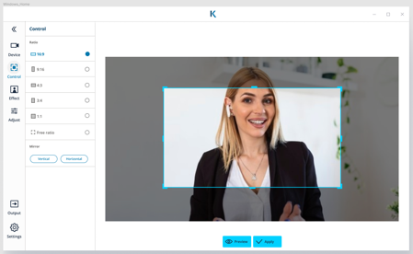
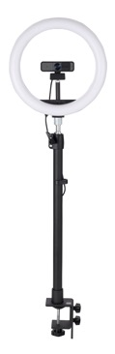
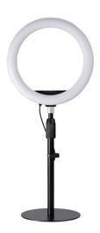
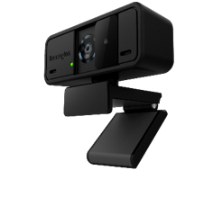
Pro Videoconferencing Solutions
Webcams
Mounting & Lighting Accessories
KensingtonKonnect webcam software

Slide 28
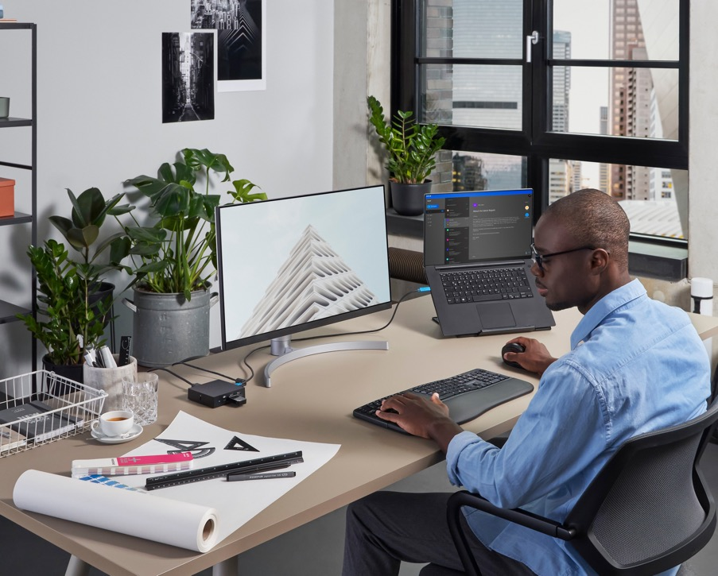
Ergonomics
Wellness and ergonomics continue to play
an increasing role in the evolving workplace. Professionals are looking to improve their overall health and wellbeing wherever their office may be. Kensington solutions provide a personalized fit, exceed current industry standards, and are considered a thought leader to the category.

Slide 29
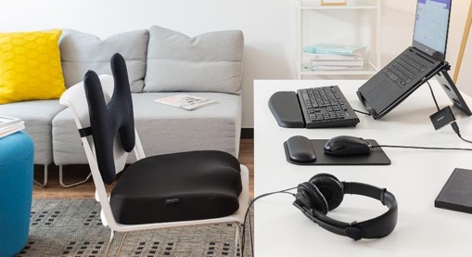











The New Office
Whether employees are working from home, the office, or somewhere in between, the requirements of a mobile or hybrid workforce present unique challenges.
Kensington crafts professional grade solutions to ensure
businesses and their employees are outfitted for comfort
and success, no matter the environment.
 | Standing Desks | Foot Rests | Back Rests | Seat Cushions | Laptop Risers | Monitor Stands | Monitor Arms | Mouse Pads Wrist Rests | Copyholders | Input Devices | Laptop Cases | Hygiene/ Sanitation
Upper Body | • |  |  |  | • | • | • | • | • | •
Lower Body | • | • | • | •
Whole Body | • | • |  |  |  | • | • |  |  |  | • | •

Slide 30
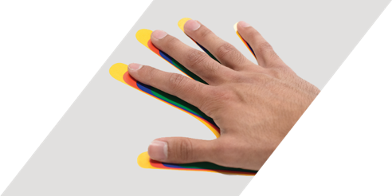
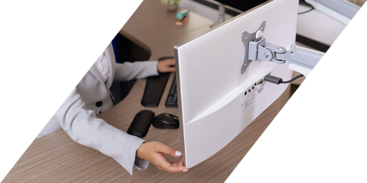
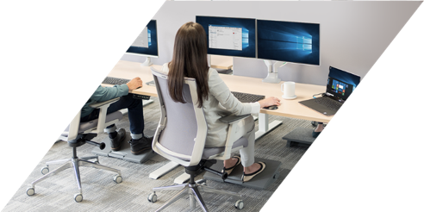

SmartFit® Ergonomics
1. Measure
2. Adjust
3. Fit
Kensington SmartFit® products feature a color-coded adjustment for optimal fit. Using the included chart, measure your hand and determine your SmartFit® comfort color. Then simply adjust the SmartFit® product to match for personalized comfort in your desktop accessories.

Slide 31
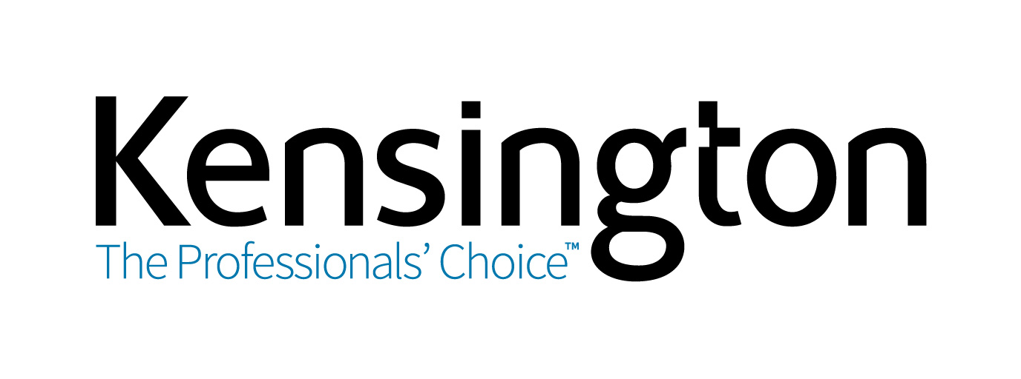

Slide 32

Thank you!
March 31, 2022

