Slide 1
Guidelines for the new template
Example slides have been included – you can find additional templates by clicking New Slide in the Home menu
Product images with transparent background can be found at the following link: https://kensington.box.com/s/p6i2xww2i5srsaljnvd5n22bgze9aa6m
On slides with a lot of text please follow the 7x7x7 rule: For every slide, use no more than seven lines of text — or seven bullet points — and no more than seven words per line.
Please use Ubuntu Light for headlines and Open Sans regular font for body copy – the fonts are embedded in the document if you need to download them for any reason you can find and download them from our brand guidelines

Slide 2
Colors
The color pallet should follow new brand guidelines
More guidance can be found at our Brand Center
Kensington sky blue
Kensington blue
Kensington dark blue
Kensington light gray
Kensington mid light gray
Black

Slide 3
Images
Images for title and section slides have been provided in the template for convenience
Please use Kensington originals vs. stock photography
If you need to change the image to suit your presentation, follow these steps:
Click on View and then Slide Master
In the left slide sorter, click on the slide you would like to edit
Delete existing image and add new image
(NOTE: please ensure that the resolution of the image is suited to full screen viewing or in general high enough without getting pixelated)

Slide 4
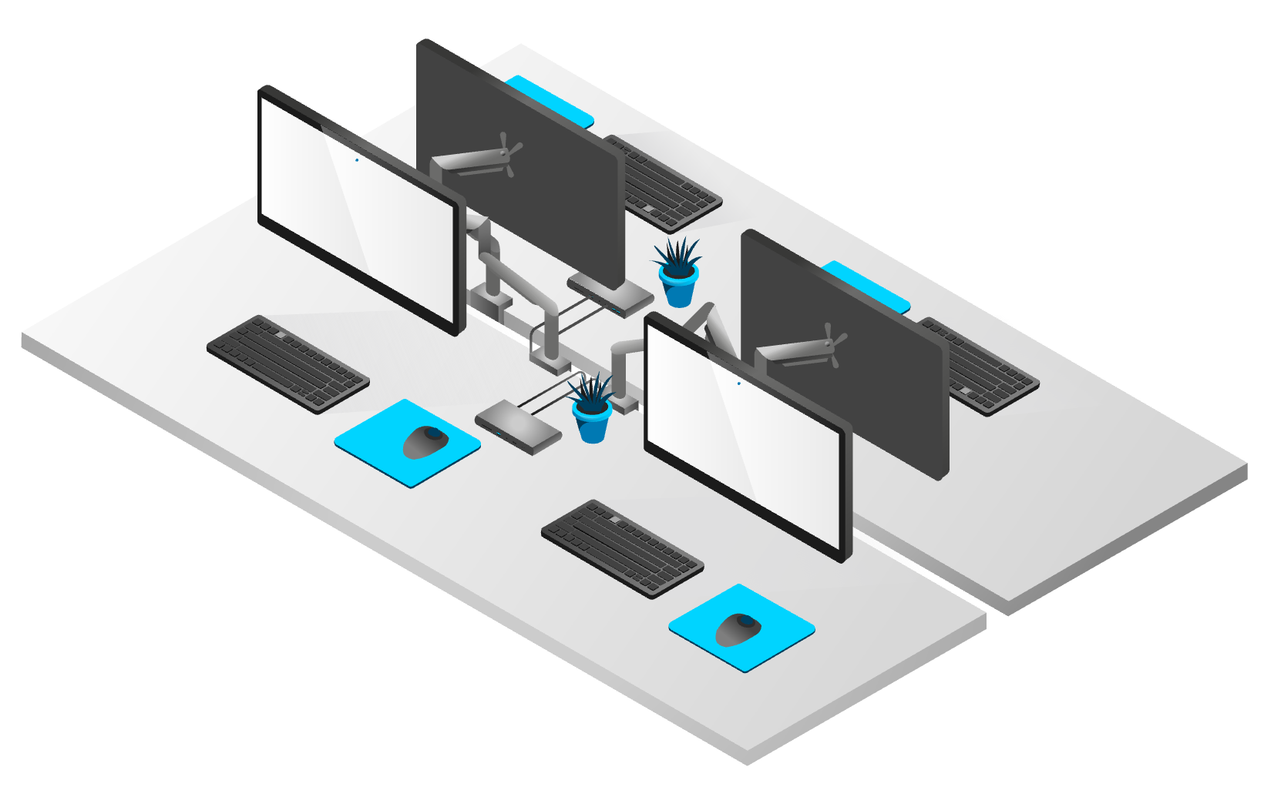
Illustrations

Slide 5
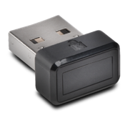
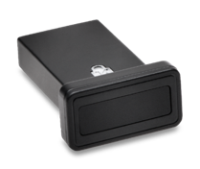
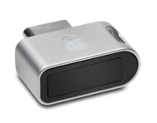
Table Slide Example
 | Item 1 | Item 2 | Item 3 | Item 4
Item 1 | Feature 11 | Feature 12 | Feature 13 | Feature 14
Item 2 | Feature 21 | Feature 22 | Feature 23 | Feature 24
Item 3 | Feature 31 | Feature 32 | Feature 33 | Feature 34
Item 4 | Feature 41 | Feature 42 | Feature 43 | Feature 44
Item 5 | Feature 51 | Feature 52 | Feature 53 | Feature 54

Slide 6
Analytics
Key Takeaways
Point 1
Point 2
Sub-bullet

